Slide 1
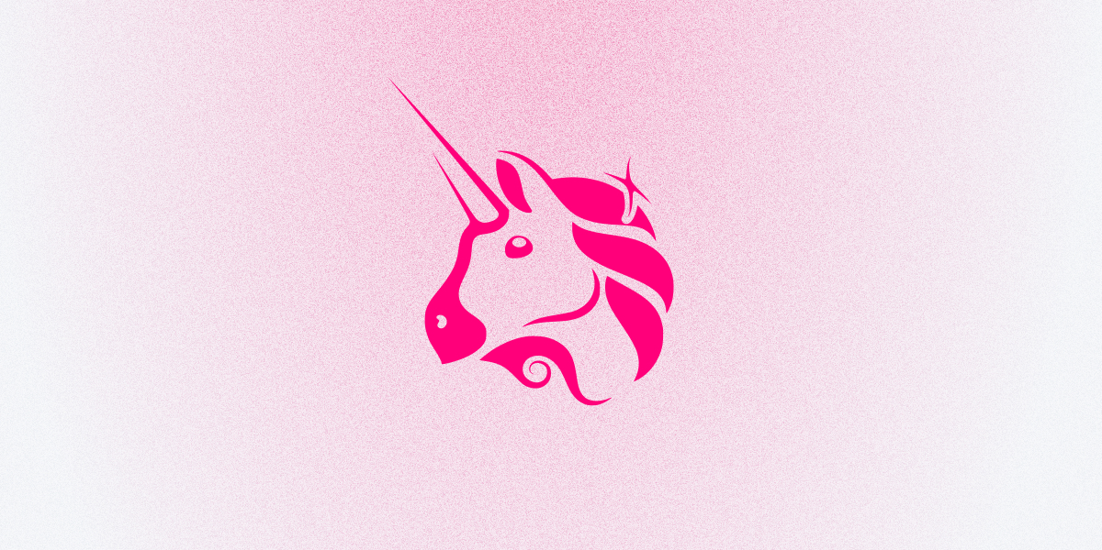
Uniswap
BY : —— ASHISH baberwal
Decentralized Exchanges

Slide 2
— Uniswap is an automated ethereum-based crypto exchange with its own governance token, UNI.
Order book-based trading is where buy and sell orders are presented in a list along with the total amount placed in each order
The amount of open buy and sell orders for an asset is known as “market depth.” In order to make a successful trade using this system, a buy order has to be matched with a sell order on the opposite side of the order book for the same amount and price of an asset, and vice versa
The main problem with this type of system is liquidity, which in this context refers to the depth and number of orders there are on the order book at any given time. If there’s low liquidity, it means traders may not be able to fill their buy or sell orders.
Another way to think of liquidity: Imagine you own a food stall in a street market. If the street market is busy with stall owners selling goods and people buying produce and products, it would be considered a "liquid market." If the market was quiet and there was little buying and selling going on, it would be considered a "narrow market."

Slide 3
What is Uniswap?
Uniswap is a completely different type of exchange that‘s fully decentralized
The Uniswap platform was built in 2018 on top of the Ethereum blockchain, the world’s second-largest cryptocurrency project by market capitalization.
It compatible with all ERC-20 tokens and infrastructure such as wallet services like MetaMask and MyEtherWallet
Completely open source
Means anyone can copy the code to create their own decentralized exchanges.
By retaining control of private keys, it eliminates the risk of losing assets if the exchange is ever hacked
According to the latest figures, Uniswap is currently the fourth-largest decentralized finance (DeFi) platform and has over $3 billion worth of crypto assets locked away on its protocol.

Slide 4
How Uniswap works
Uniswap runs on two smart contracts; an “Exchange” contract and a “Factory” contract.
In this instance, the factory smart contract is used to add new tokens to the platform and the exchange contract facilitates all token swaps, or “trades.” Any ERC20-based token can be swapped with another on the updated Uniswap v.2 platform.

Slide 5
Automated liquidity protocol
The way Uniswap solves the liquidity problem of centralized exchanges is through an automated liquidity protocol.
Each token listed has its own pool that users can contribute to, and the prices for each token are worked out using a math algorithm run by a computer
With this system, a buyer or seller does not have to wait for an opposite party to appear to complete a trade. Instead, they can execute any trade instantly at a known price provided there’s enough liquidity in the particular pool to facilitate it
Ex. Exchange charges fees
Whenever a liquidity provider decides they want to exit, they receive a portion of the total fees from the reserve relative to their staked amount in that pool. The token they received which keeps a record of what stake they’re owed is then destroyed.
After the Uniswap v.2 upgrade, a new protocol fee was introduced that can be turned on or off via a community vote and essentially sends 0.05% of every 0.30% trading fee to a Uniswap fund to finance future development.
Currently, this fee option is turned off, however, if it is ever turned on it means LPs will start receiving 0.25% of pool trading fees.

Slide 6
How token price is determined
Uniswap uses an automated market maker system.
It works by increasing and decreasing the price of a coin depending on the ratio of how many coins there are in the respective pool.
It’s important to note that whenever someone adds a new ERC-20 token to Uniswap, that person has to add a certain amount of the chosen ERC-20 token and an equal amount of another ERC-20 token to start the liquidity pool.
Ex. For example, Bob wants to trade chainlink (LINK) for ether using the Uniswap LINK/ETH pool. Bob adds a large number of LINK to the pool which increases the ratio of LINK in the pool to ether. Since the value K must remain the same, it means the cost of ether increases while the cost of link in the pool decreases. So the more LINK Bob puts in, the less ether he gets in return because the price of it increases.
The size of the liquidity pool also determines how much the price of tokens will change during a trade. The more money, aka liquidity, there is in a pool, the easier it is to make larger trades without causing the price to slide as much

Slide 7
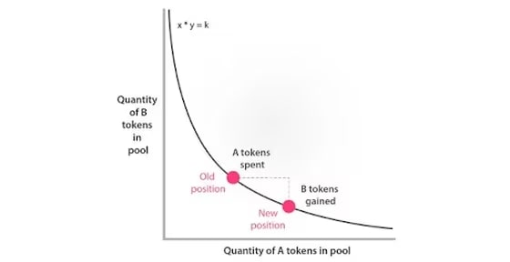
Quantity of A token in pool

Slide 8
How to use Uniswap
Once you have ERC-20 supported wallet setup such as MetaMask, WalletConnect, Coinbase wallet, Portis, or Fortmatic., you need to add ether to it in order to trade on Uniswap and pay for gas – this is what Ethereum transaction fees are called.
Most ERC-20 compatible wallet services give you three choices when making a payment over the Ethereum blockchain: slow, medium or fast
This determines how quickly your transaction is processed by Ethereum network miners.

Slide 9
Uniswap's UNI token
Uniswaps native token, UNI, is known as a governance token
This gives holders the right to vote on new developments and changes to the platform, including how minted tokens should be distributed to the community and developers as well as any changes to fee structures.
The UNI token was originally created in September 2020 in an effort to prevent users from defecting to rival DEX SushiSwap
One month before UNI tokens launched, SushiSwap – a fork of Uniswap – had incentivized users from Uniswap to allow SushiSwap to reallocate their funds to the new platform by rewarding them with SUSHI tokens.
Uniswap responded by creating 1 billion UNI tokens and decided to distribute 150 million of them to anybody who had ever used the platform. Each person received 400 UNI tokens, which at the time amounted to over $1,000.

